Slide 1
EZ-Apart
10/08/2019
.
Animish Andraskar | aandrask@andrew.cmu.edu
May Li | xumeil@andrew.cmu.edu
Trista Pierce | tlpierce@andrew.cmu.edu
Xiaobin Shen | xiaobins@andrew.cmu.edu

Slide 2
AGENDA
Vision
Team
Problem
Approach / Solution
Market
Business Model
Competition
Go-to-Market

Slide 3
VISION
What is your vision?
To help CMU students easily and conveniently look for apartments while keeping their interests in mind.

Slide 4
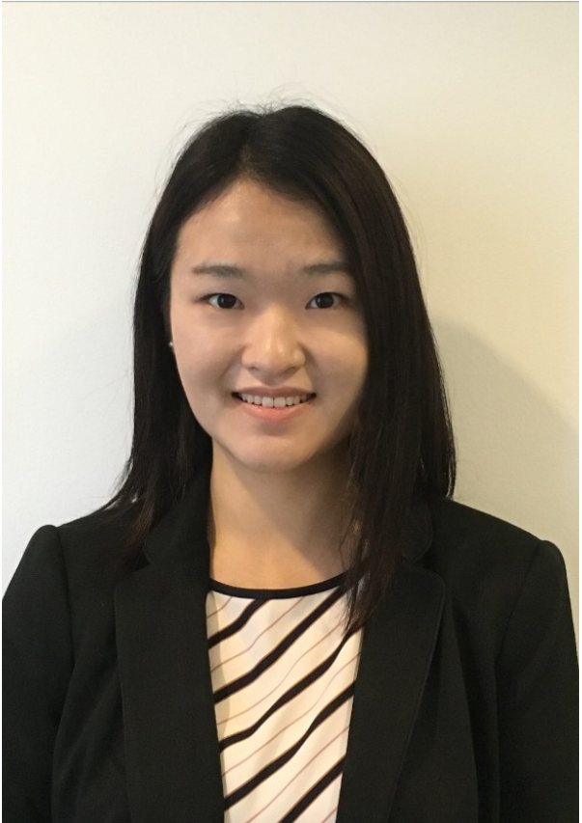
TEAM
Animish Andraskar (Co-Founder)
Linkedin profile - https://www.linkedin.com/in/xumei-li/
Animish is currently studying Business Intelligence and Data Analytics at Carnegie Mellon University. Before that, he has worked as a data analyst for 3.5 years solving complex business problems for various Fortune 500 companies deriving data-driven
May Li (Co-Founder)
Linkedin profile - https://www.linkedin.com/in/xumei-li/
May is a full-time graduate student at Carnegie Mellon University majoring in Information Systems Management with a concentration in Business Intelligence and Data Analytics. May holds dual Bachelor’s degrees in Information Systems and Accounting with a Statistics minor from University of Maryland College Park. Before joining the company, May worked as a Senior Technology Risk Consultant at a public accounting firm for 3+ years.

Slide 5
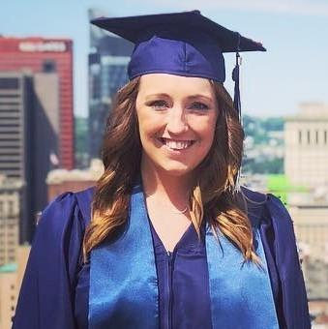

TEAM
Trista Pierce (Co-Founder)
LinkedIn Profile: https://www.linkedin.com/in/tristapierce812/ Trista is a graduate student majoring in Information Systems Management at Carnegie Mellon University with concentration in Business Intelligence and Data Analytics. Trista holds a Bachelor’s degree in Applied Mathematics with a Data Analytic minor from Robert Morris University. Before joining the company, Trista worked for six years as a nuclear reactor operator and electronics technician for the United States Navy.
Xiaobin Shen (Co-Founder) LinkedIn Profile: https://www.linkedin.com/in/xiaobin-shen-data/ Xiaobin is currently pursuing a Master’s degree of Information Systems Management at Carnegie Mellon University with concentration in Business Intelligence and Data Analytics. Xiaobin got her bachelor’s degree in Information Management and Information Systems in Zhejiang University. She was data analyst intern of tech company in China before she started this company.

Slide 6
PROBLEM (CUSTOMER PAIN)
What is the customer pain point?
In order to look for an apartment, CMU students need to gather information, such as apartment availabilities, prices and location, crime rates, transportation options, and nearby restaurants. This requires information collection from multiple reliable sources.
What is the current solution for this pain?
CMU students currently need to spend a great amount of time navigating multiple sources and websites to collect the adequate amount useful information when in search of apartments.

Slide 7
PROBLEM (CUSTOMER PAIN)
How much does it cost?
According to a survey conducted, 82% of CMU students surveyed claimed that they spend over 3 days researching apartments and taking physical tours.
Why is it broken?
Time spent navigating multiple websites is tedious and time consuming.
Some necessary information, such as bus routes, is not easily found, as it requires some familiarity of the Pittsburgh bus system.
Important information may be neglected
For example, a student may not think restaurants are as important until he or she moves here and realizes there is no time for cooking.

Slide 8
SOLUTION / PRODUCT
Explain your product
It is a product targeted to CMU students looking for apartments by what they find important. There will be three areas where we collect data- Shadyside, Squirrel Hill, and Oakland.
The customer will rate the following 3 topics by what is important to them:
Public Transportation
Crime
Restaurants
This data is collected from various platforms such as Trulia, Yelp, GoogleMaps, and Allegheny Crime Report.
By the order in which they rate the interests, our product will produce the best area (either Shadyside, Squirrel Hill, or Oakland) and display the top 5 rated apartment complexes and with their calculated intelligence score.

Slide 9
SOLUTION / PRODUCT (continued)
Value proposition
We will provide the most convenient searching and filtering experience for CMU students who are looking for apartments.
We provide the most comprehensive and reliable information for apartment searching
Demonstrate the impact on your customer (dollars / time saved, etc.)
An estimated average of 3 days saved per person.
A better apartment search platform and engine gives customers more options to satisfy their need. Customers have more freedom to select from these options and consider apartments that are in their budget and are catered to their interests.
Enable customers to rent a place with confidence backed by real world data.

Slide 10
MARKET
Describe your market / target customer
All CMU students who desire to rent an apartment near campus
How big is the market?
Number of CMU students: 14625 (according to Fall 2018 Demographics from CMU website)
What are the market forces / drivers?
Absence of a comprehensive apartment searching platform
There is more need of such platform in concentrated college areas

Slide 11
BUSINESS MODEL / UNIT ECONOMICS
How does your company make money?
EZ Apart makes money through advertising and sponsorship. We sell empty space on our platform to advertisers targeting college students. We also allocate top two extra results to the apartments who are willing to sponsor us.
Pricing details (include metrics):
Average Order Value (AOV)
PPM (Pay per click) - $2.00 for 1000 clicks
Lifetime Value (LTV)
This would depend on the traffic of our platform. If the ads on our platform receive 1,000,000 clicks per day, we could make $730,000 a year.

Slide 12
COMPETITION
Frame the competition:
Who are the key players?
Current apartment listing websites such as apartments.com
How are you differentiated?
Our platform provides, not only information about the apartment itself, but also other important relevant information that helps students make a wise and quick decision on their future apartment with their personalized goals in mind. Our platform also provides a ranking with this relevant information being considered.

Slide 13
LAUNCH STRATEGY / GO-TO-MARKET
Customer Acquisition Approach
We plan to acquire customers through online marketing and physical marketing campaigns around CMU campus.
Students in current Python class as our first group of customers
Online marketing, by partnering with student organizations that help students transition to living in Pittsburgh
Distribute and post flyers and brochures on campus

Slide 14
LAUNCH STRATEGY / GO-TO-MARKET
What are key drivers and potential milestones?
Drivers | Dates to Be Completed
Data Gathering | 9/14
Connecting Data Sources | 9/17
Analysis | 9/20
Building Platform | 10/01
Testing Platform | 10/04
Platform Implementation | 10/08

Slide 15
Lessons Learned
Teamwork and Communication
First, our group only used WhatsApp and shared GoogleDocs
We improved our communication by the use of GitHub
GitHub is platform used for technical projects. We used a repository to save the codes and the files in one place.

